Slide 1
Aesthetics of Colour in Mathematical Diagramming
Eva Knoll, Wendy Landry, Tara Taylor, Paul Carreiro, Katie Puxley & Karyn Harrison

Slide 2
Intentional Colouring
When diagramming for mathematical purposes, graphical decisions can derive from aesthetic or mathematical intentions.
Applying colour to a diagram is no exception.
Please choose some colours and begin colouring the front cover of the booklet… Reflect on your intentions.

Slide 3
Colouring Intention
What intentions coloured your decisions? Did you consider:
Counting elements?
Counting elements?
Counting elements?
Counting elements?
Counting elements?
Counting elements?
Counting elements?
Counting elements?
Counting elements?
Counting elements?
Counting elements?
Counting elements?
Counting elements?
Counting elements?
Counting elements?
Counting elements?
Counting elements?
Counting elements?
Counting elements?
Counting elements?
Counting elements?
Counting elements?
Counting elements?
Counting elements?
Counting elements?
Counting elements?
Counting elements?
Counting elements?
Counting elements?
Counting elements?
Counting elements?
Counting elements?
Counting elements?
Counting elements?
Counting elements?
Counting elements?
Counting elements?
Counting elements?
Counting elements?
Counting elements?
Counting elements?
Counting elements?
Counting elements?
Counting elements?
Counting elements?
Counting elements?
Counting elements?
Counting elements?
Counting elements?
Counting elements?
Counting elements?
Counting elements?
Counting elements?
Counting elements?
Counting elements?
Difference?
Difference?
Difference?
Difference?
Difference?
Difference?
Difference?
Difference?
Difference?
Difference?
Difference?
Difference?
Difference?
Difference?
Difference?
Difference?
Difference?
Difference?
Difference?
Difference?
Difference?
Difference?
Difference?
Difference?
Difference?
Difference?
Difference?
Difference?
Difference?
Difference?
Difference?
Difference?
Difference?
Difference?
Difference?
Difference?
Difference?
Difference?
Difference?
Difference?
Difference?
Difference?
Difference?
Difference?
Difference?
Difference?
Difference?
Difference?
Difference?
Difference?
Difference?
Difference?
Difference?
Difference?
Difference?
Continuity?
Continuity?
Continuity?
Continuity?
Continuity?
Continuity?
Continuity?
Continuity?
Continuity?
Continuity?
Continuity?
Continuity?
Continuity?
Continuity?
Continuity?
Continuity?
Continuity?
Continuity?
Continuity?
Continuity?
Continuity?
Continuity?
Continuity?
Continuity?
Continuity?
Continuity?
Continuity?
Continuity?
Continuity?
Continuity?
Continuity?
Continuity?
Continuity?
Continuity?
Continuity?
Continuity?
Continuity?
Continuity?
Continuity?
Continuity?
Continuity?
Continuity?
Continuity?
Continuity?
Continuity?
Continuity?
Continuity?
Continuity?
Continuity?
Continuity?
Continuity?
Continuity?
Continuity?
Continuity?
Continuity?
Symmetry?
Symmetry?
Symmetry?
Symmetry?
Symmetry?
Symmetry?
Symmetry?
Symmetry?
Symmetry?
Symmetry?
Symmetry?
Symmetry?
Symmetry?
Symmetry?
Symmetry?
Symmetry?
Symmetry?
Symmetry?
Symmetry?
Symmetry?
Symmetry?
Symmetry?
Symmetry?
Symmetry?
Symmetry?
Symmetry?
Symmetry?
Symmetry?
Symmetry?
Symmetry?
Symmetry?
Symmetry?
Symmetry?
Symmetry?
Symmetry?
Symmetry?
Symmetry?
Symmetry?
Symmetry?
Symmetry?
Symmetry?
Symmetry?
Symmetry?
Symmetry?
Symmetry?
Symmetry?
Symmetry?
Symmetry?
Symmetry?
Symmetry?
Symmetry?
Symmetry?
Symmetry?
Symmetry?
Symmetry?
Order?
Order?
Order?
Order?
Order?
Order?
Order?
Order?
Order?
Order?
Order?
Order?
Order?
Order?
Order?
Order?
Order?
Order?
Order?
Order?
Order?
Order?
Order?
Order?
Order?
Order?
Order?
Order?
Order?
Order?
Order?
Order?
Order?
Order?
Order?
Order?
Order?
Order?
Order?
Order?
Order?
Order?
Order?
Order?
Order?
Order?
Order?
Order?
Order?
Order?
Order?
Order?
Order?
Order?
Order?
Similarity?
Similarity?
Similarity?
Similarity?
Similarity?
Similarity?
Similarity?
Similarity?
Similarity?
Similarity?
Similarity?
Similarity?
Similarity?
Similarity?
Similarity?
Similarity?
Similarity?
Similarity?
Similarity?
Similarity?
Similarity?
Similarity?
Similarity?
Similarity?
Similarity?
Similarity?
Similarity?
Similarity?
Similarity?
Similarity?
Similarity?
Similarity?
Similarity?
Similarity?
Similarity?
Similarity?
Similarity?
Similarity?
Similarity?
Similarity?
Similarity?
Similarity?
Similarity?
Similarity?
Similarity?
Similarity?
Similarity?
Similarity?
Similarity?
Similarity?
Similarity?
Similarity?
Similarity?
Similarity?
Similarity?
Structure?
Structure?
Structure?
Structure?
Structure?
Structure?
Structure?
Structure?
Structure?
Structure?
Structure?
Structure?
Structure?
Structure?
Structure?
Structure?
Structure?
Structure?
Structure?
Structure?
Structure?
Structure?
Structure?
Structure?
Structure?
Structure?
Structure?
Structure?
Structure?
Structure?
Structure?
Structure?
Structure?
Structure?
Structure?
Structure?
Structure?
Structure?
Structure?
Structure?
Structure?
Structure?
Structure?
Structure?
Structure?
Structure?
Structure?
Structure?
Structure?
Structure?
Structure?
Structure?
Structure?
Structure?
Structure?
Pattern?
Pattern?
Pattern?
Pattern?
Pattern?
Pattern?
Pattern?
Pattern?
Pattern?
Pattern?
Pattern?
Pattern?
Pattern?
Pattern?
Pattern?
Pattern?
Pattern?
Pattern?
Pattern?
Pattern?
Pattern?
Pattern?
Pattern?
Pattern?
Pattern?
Pattern?
Pattern?
Pattern?
Pattern?
Pattern?
Pattern?
Pattern?
Pattern?
Pattern?
Pattern?
Pattern?
Pattern?
Pattern?
Pattern?
Pattern?
Pattern?
Pattern?
Pattern?
Pattern?
Pattern?
Pattern?
Pattern?
Pattern?
Pattern?
Pattern?
Pattern?
Pattern?
Pattern?
Pattern?
Pattern?

Slide 4
Colouring Intention
What intentions coloured your decisions? Did you consider:
Counting elements?
Structure?
Order?
Pattern?
Symmetry?
Similarity?
Difference?
What past experiences and competencies did you call upon?
Did you approach this aesthetically or mathematically? Why?

Slide 5
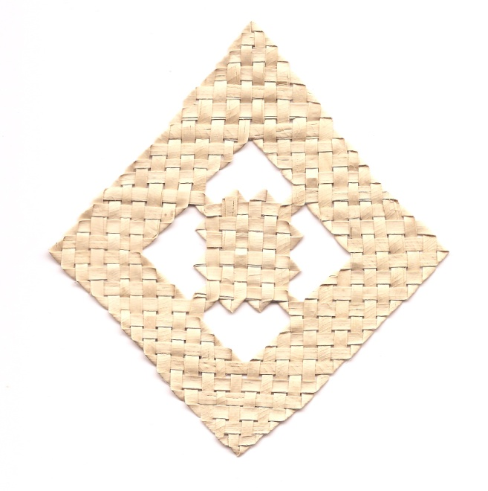
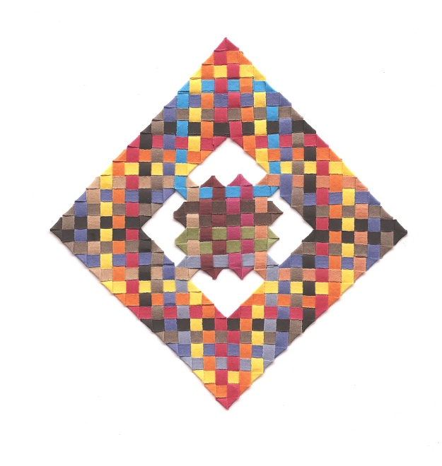
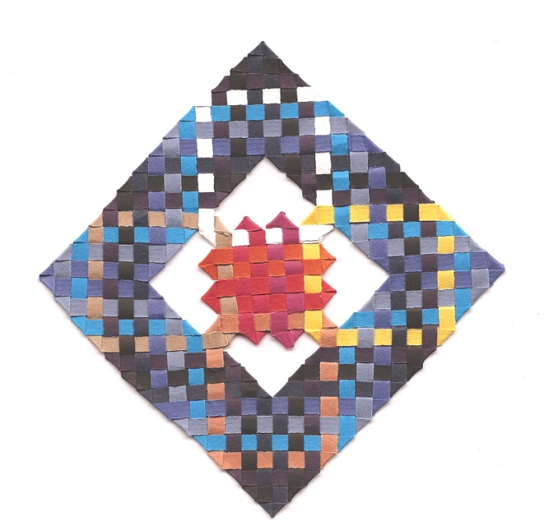
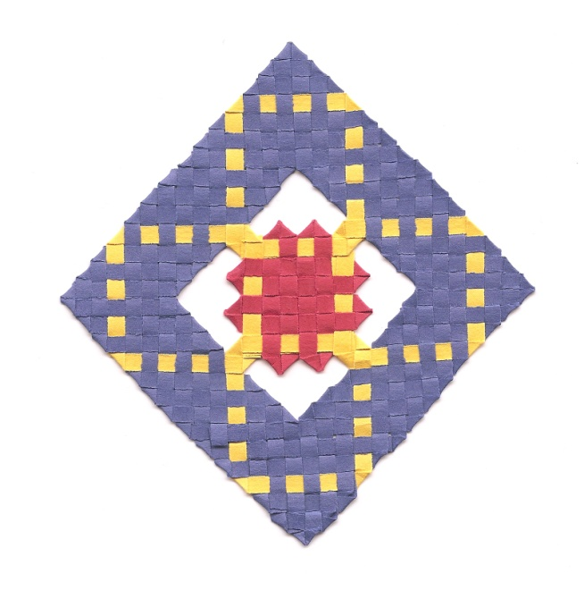
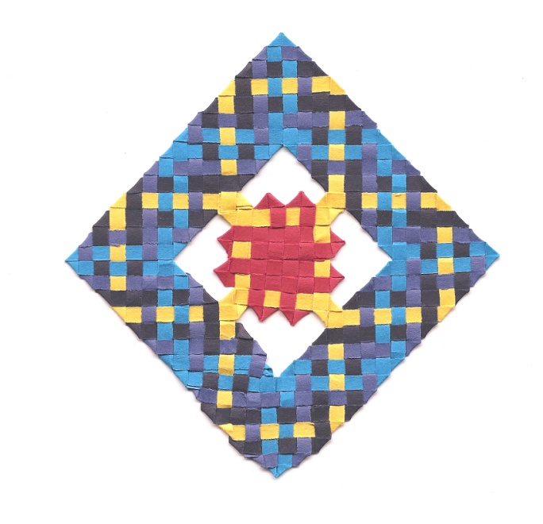

Slide 6
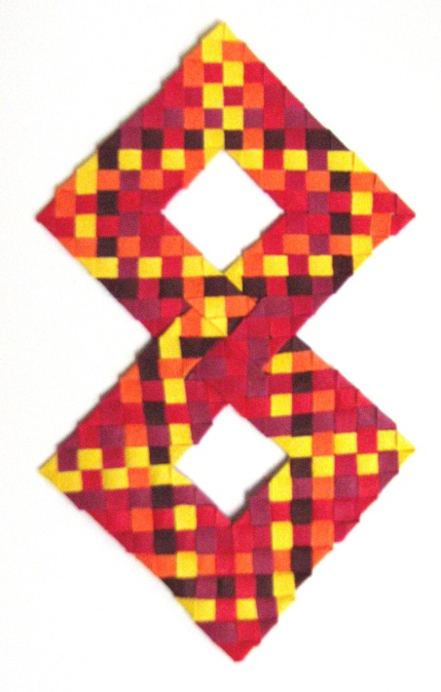
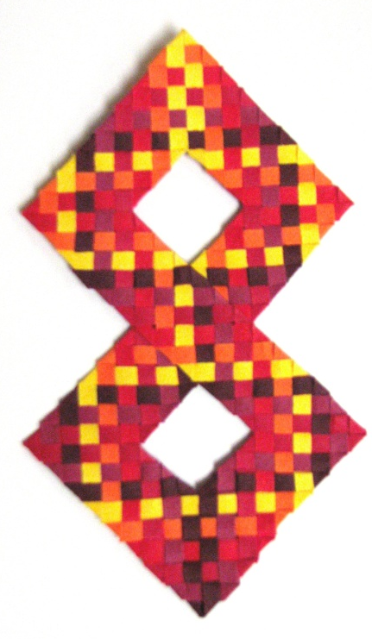
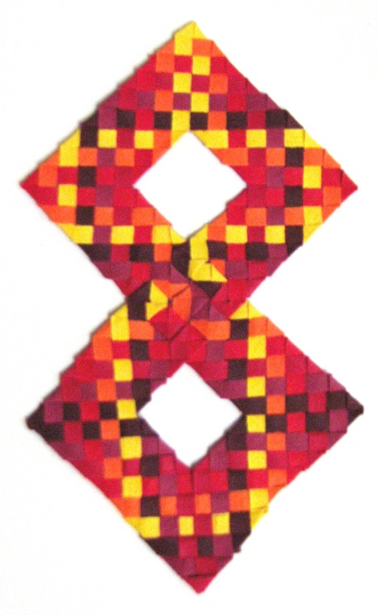

Slide 7
In mathematics the art of proposing a question must be held of higher value than solving it. (Cantor, 1867)

